Slide 1

Semi Supervised Machine Learning approach for Detecting DDoS Attack Github Link: https://github.com/knvkishorek/Batch-A-08
Batch No: A-08 Project Guide:
C.Lavanya (164G1A0547) Mr. B.Sreedhar, M.Tech.
B.Chandrika (164G1A0518) Assistant Professor`
K.N.V.Kishore Kumar (164G1A0538)
T.Kumuda (164G1A0542)
Srinivasa Ramanujan Institute of Technology
Department of Computer Science & Engineering

Slide 2
Introduction
A distributed denial-of-service (DDoS) attack is a malicious attempt to disrupt normal traffic of a targeted server, service or network by overwhelming the target or its surrounding infrastructure with a flood of Internet traffic.
DDoS attacks target websites and online services.
Most famous recent DDoS attack happened on GITHUB(February,2018)
For Detecting this problem we are proposing a new solution by using semi supervised machine learning approach.

Slide 3
Existing System
The existing Machine Learning based DDoS detection approaches can be divided into two categories. Supervised ML approaches that use generated labeled network traffic datasets to build the detection model. Two major issues are facing the supervised approaches.
First, the generation of labeled network traffic datasets is costly in terms of computation and time.
Second, due to the presence of large amount of irrelevant normal data in the incoming network traffic is noisy and reduces the performances of supervised ML classifiers.

Slide 4
Contd…
Disadvantages of existing system:
The main drawback of the unsupervised approaches is the high false positive rates.
The supervised machine learning approaches are unable to predict the new legitimate and attack behaviors

Slide 5
Proposed System
It is online semi-supervised ML approach for DDoS detection.
The unsupervised part of the approach allows to reduce the irrelevant normal traffic data for DDoS detection which allows to reduce false positive rates and increase accuracy.
Whereas, the supervised part allows to reduce the false positive rates of the unsupervised part and to accurately classify the DDoS traffic.

Slide 6
Abstract
Existing ML-based DDoS detection approaches are under two categories: supervised and unsupervised.
Supervised ML approaches for DDoS detection rely on availability of labeled network traffic datasets.
Whereas, unsupervised ML approaches detect attacks by analyzing the incoming network traffic.
Both approaches are challenged by large amount of network traffic data, low detection accuracy and high false positive rates.

Slide 7
Module Description
ADMIN:
--Dataset Analysis
--Labeled data
--Unlabeled data
--Manual adding data
--DDoS analysis
--Graphical analysis
--Stopping of Attacks
--Sending E-Mail

Slide 8
Dataset Analysis :
In this Module, we represent all the entries that we have got from the dataset for analysis.
Labeled and Unlabeled data :
Separate the labeled data based on type of result.
Manual adding data:
In this admin can check attack has happened or not on a website by adding that website URL.
Graphical analysis:
The graphical analysis is done by the values taken from the result analysis part and it can be analyzed by the graphical representations. Such as Pie chart, Column chart and Line chart here in this project.

Slide 9
Preventive Measures :
In this module, we showcase the user with some steps by following which the user can prevent the attack or reduce the effect of attack.
Sending E-Mail :
In this Module, we get the mail ID from the website by using which we send the precautionary measures to the mail ID, so that the user can be aware of the attack and can take necessary steps.

Slide 10
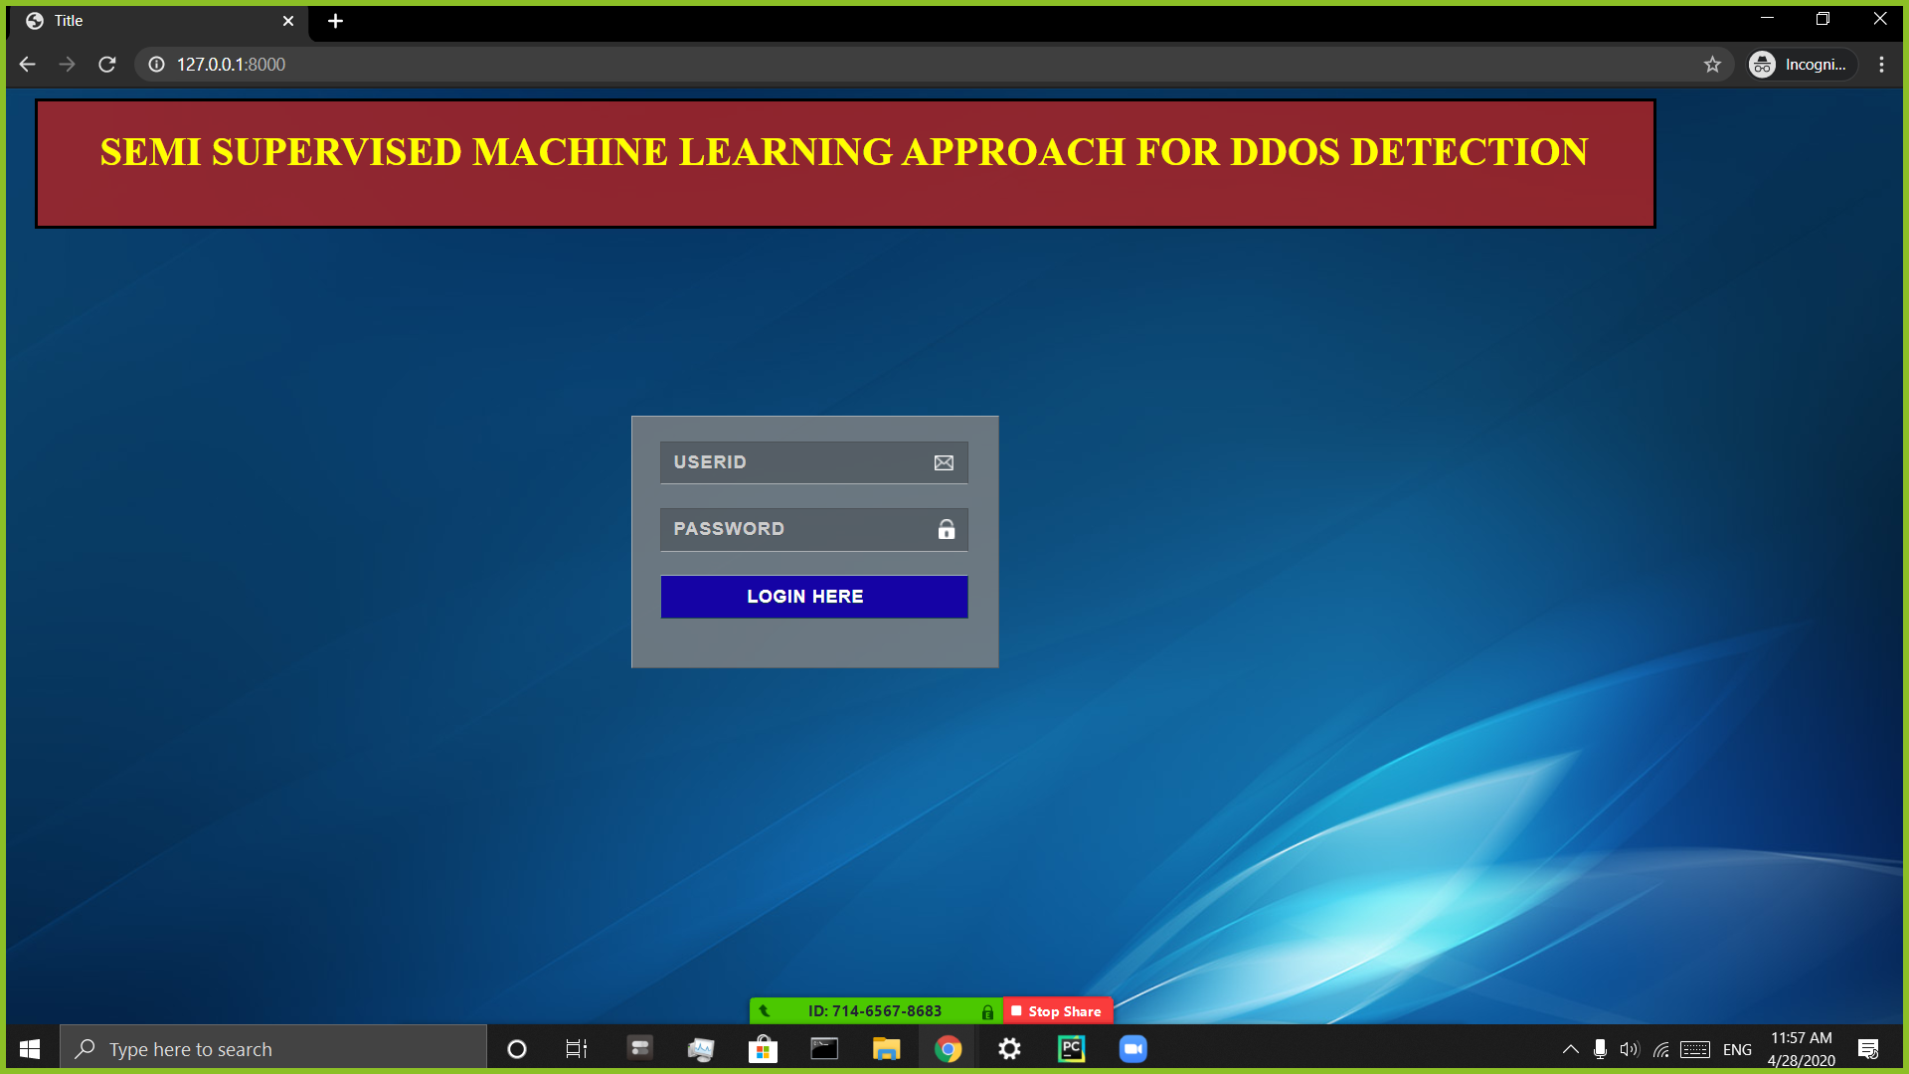
Outputs :

Slide 11
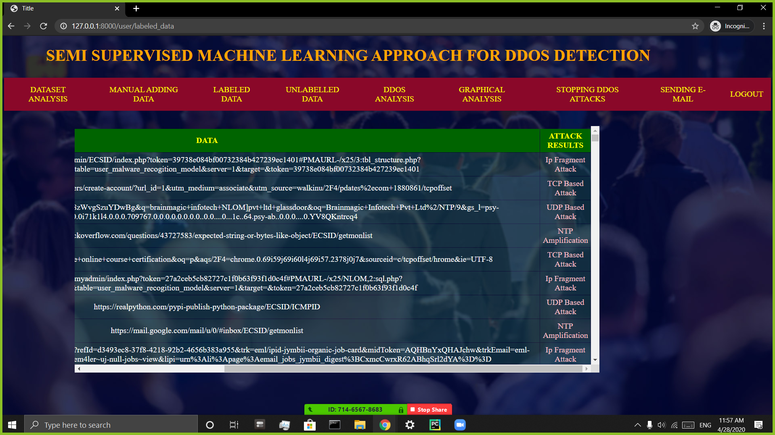

Slide 12
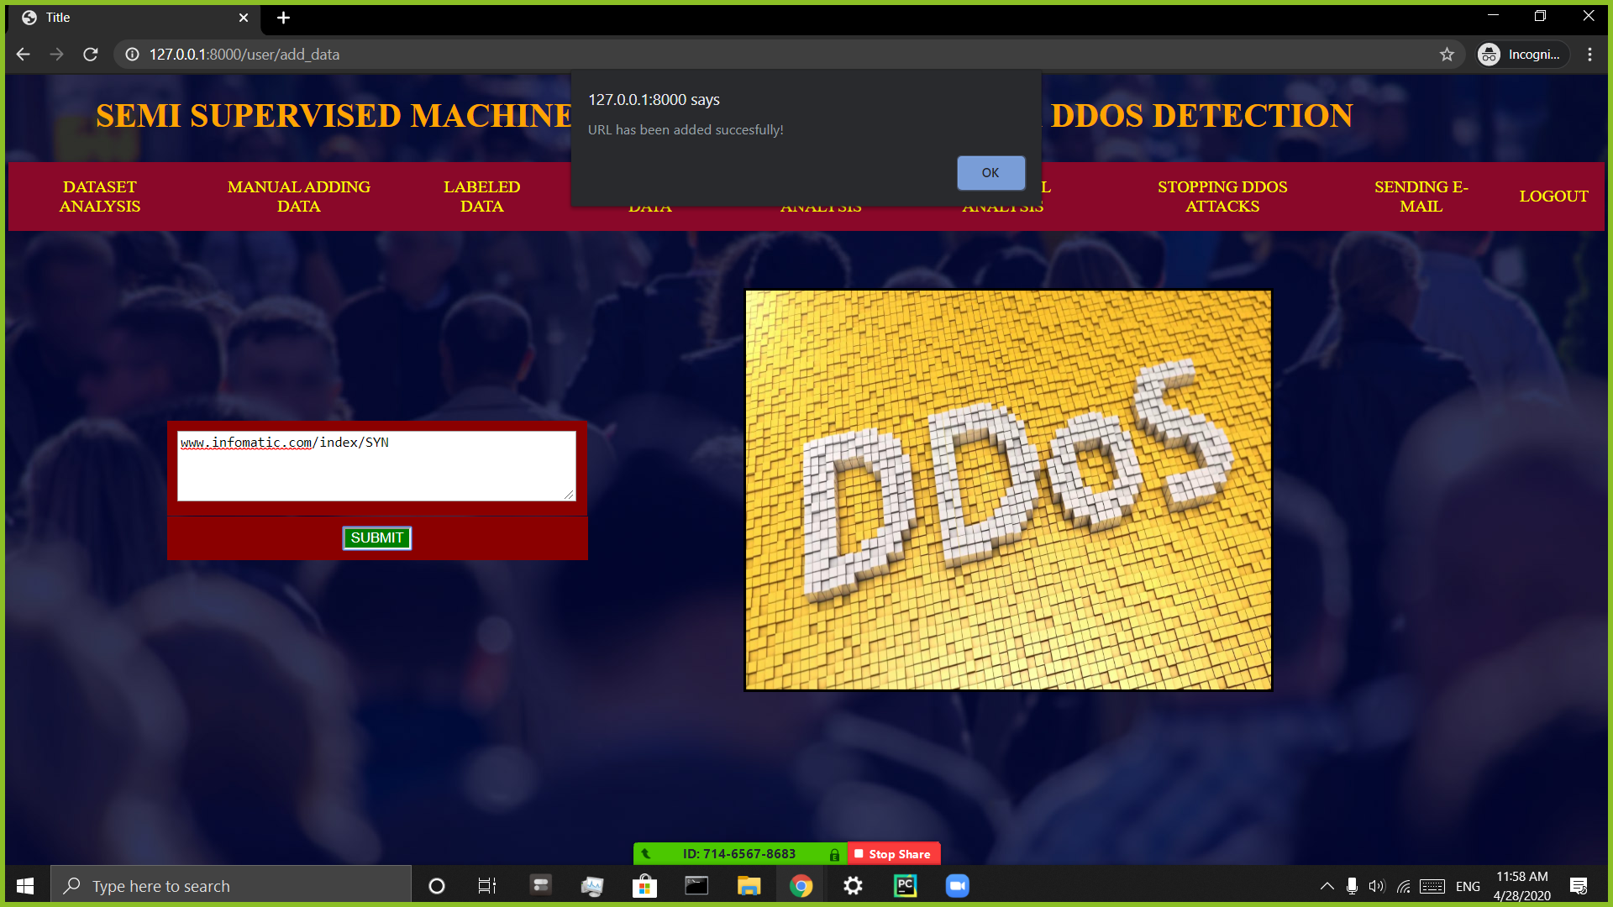

Slide 13


Slide 14


Slide 15
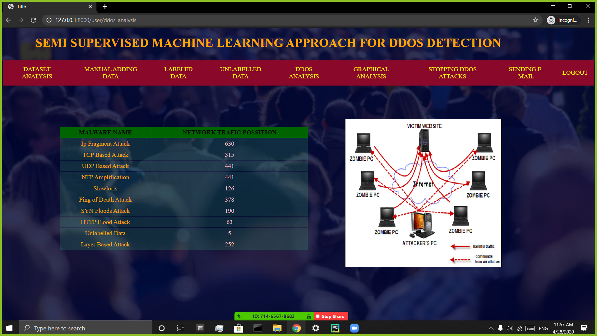

Slide 16
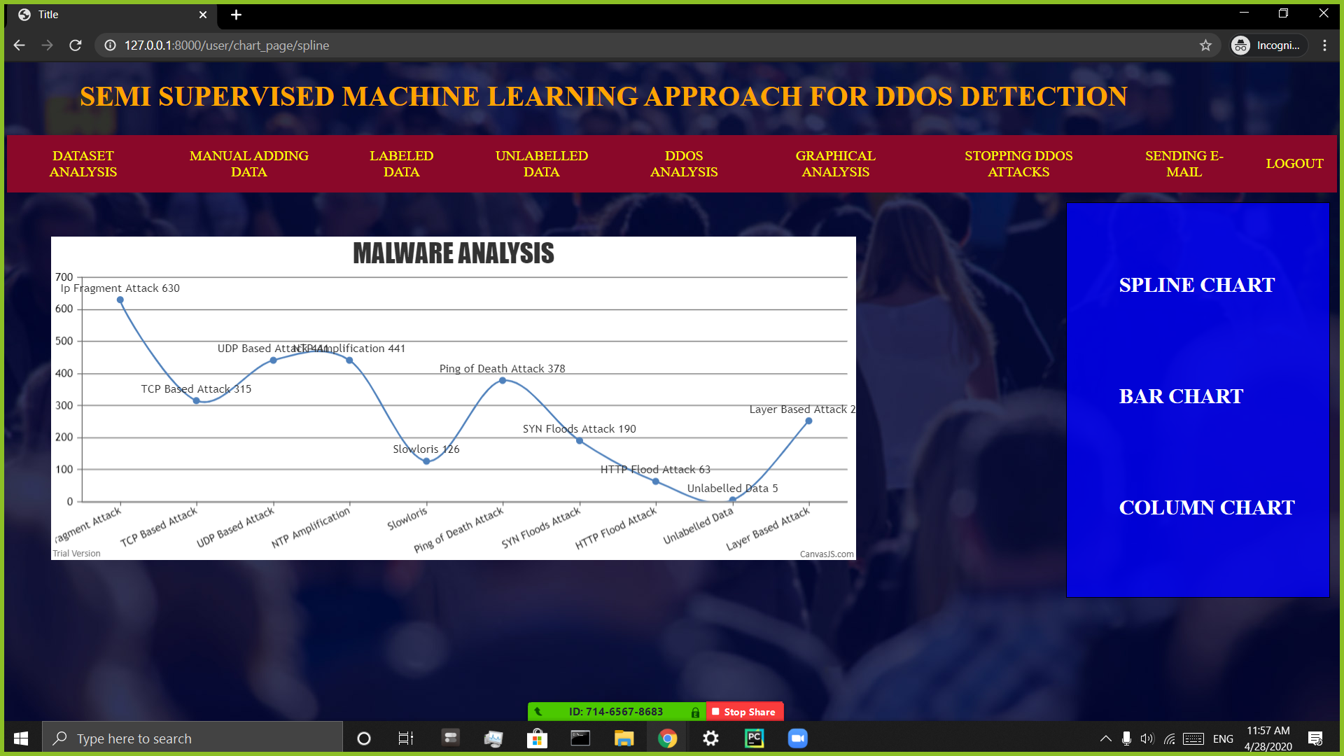

Slide 17
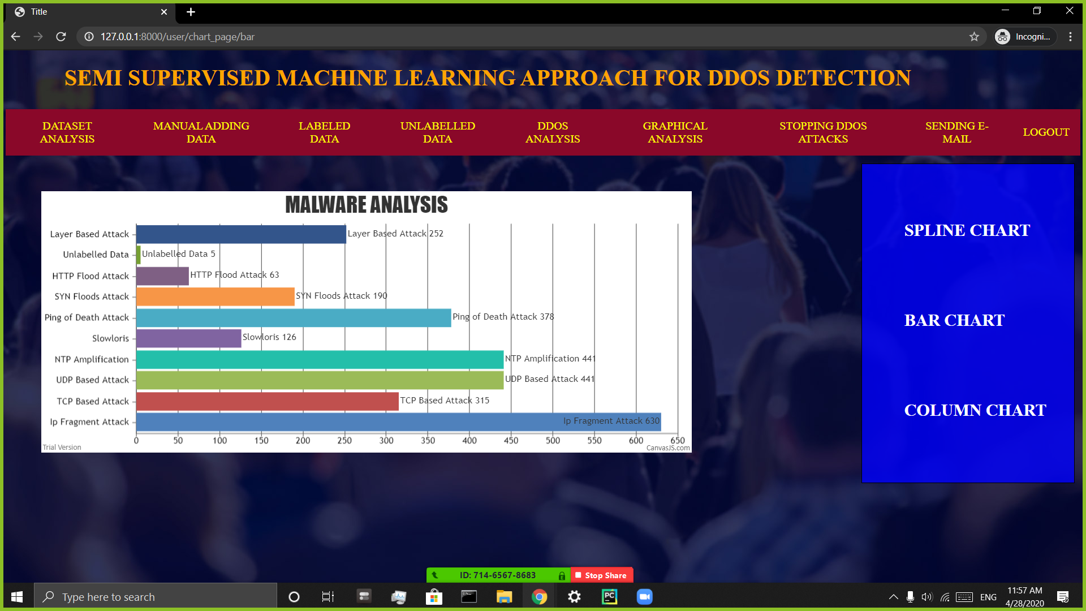

Slide 18
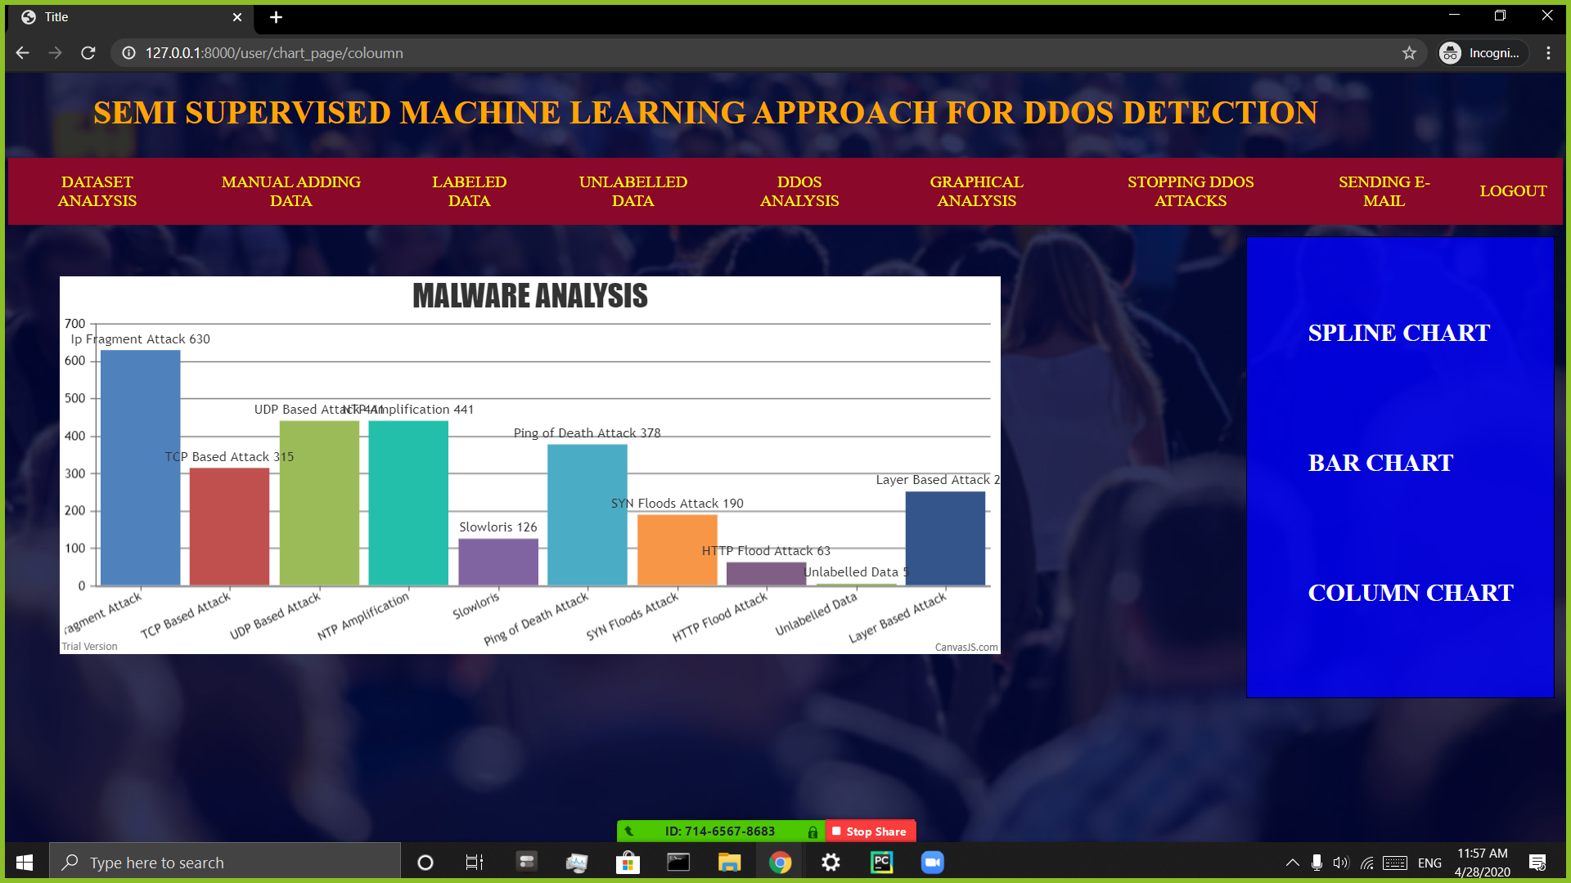

Slide 19
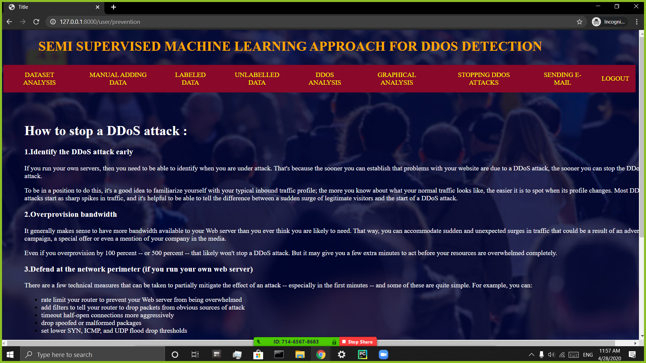

Slide 20
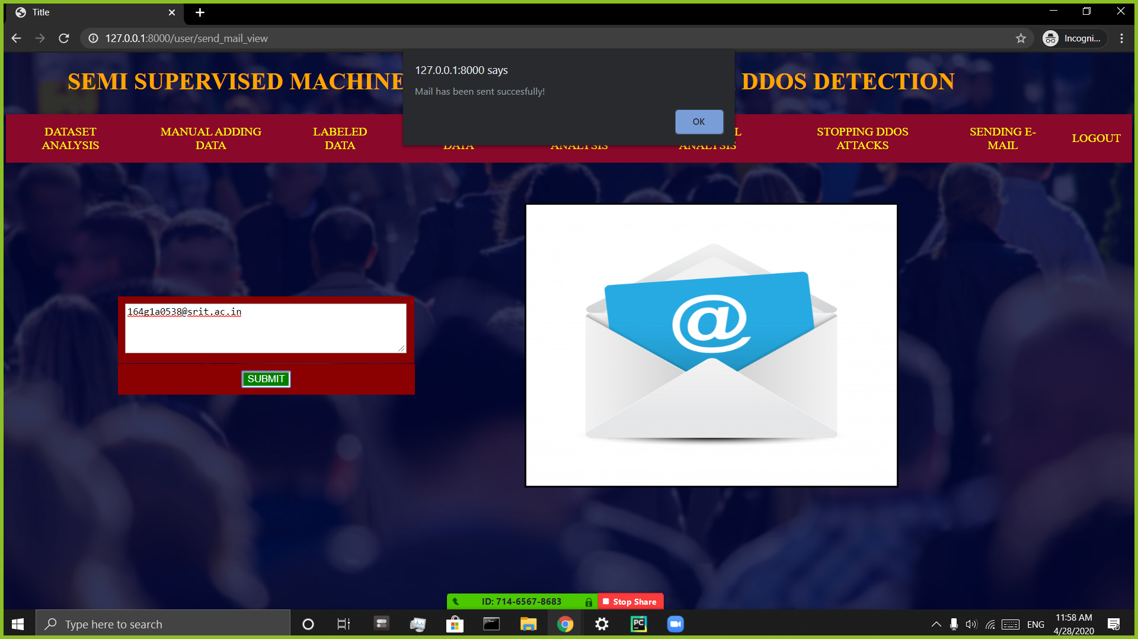

Slide 21
Conclusion
However, today Internet security is a quickly growing concern. The prevalence of Internet attacks has increased significantly, but still the challenge of detecting such attacks generally falls on the end hosts and service providers, requiring system administrators to detect and block attacks on their own.
Distributed Denial of Service(DDoS) attack is a very serious problem of web applications. Finding the efficient solution of this problem is essential. Researchers have developed many techniques to detect and prevent this vulnerability.

Slide 22
Thank you
Queries
?

